Slide 1



Team 1
Test Case (TC) Fields

Slide 2
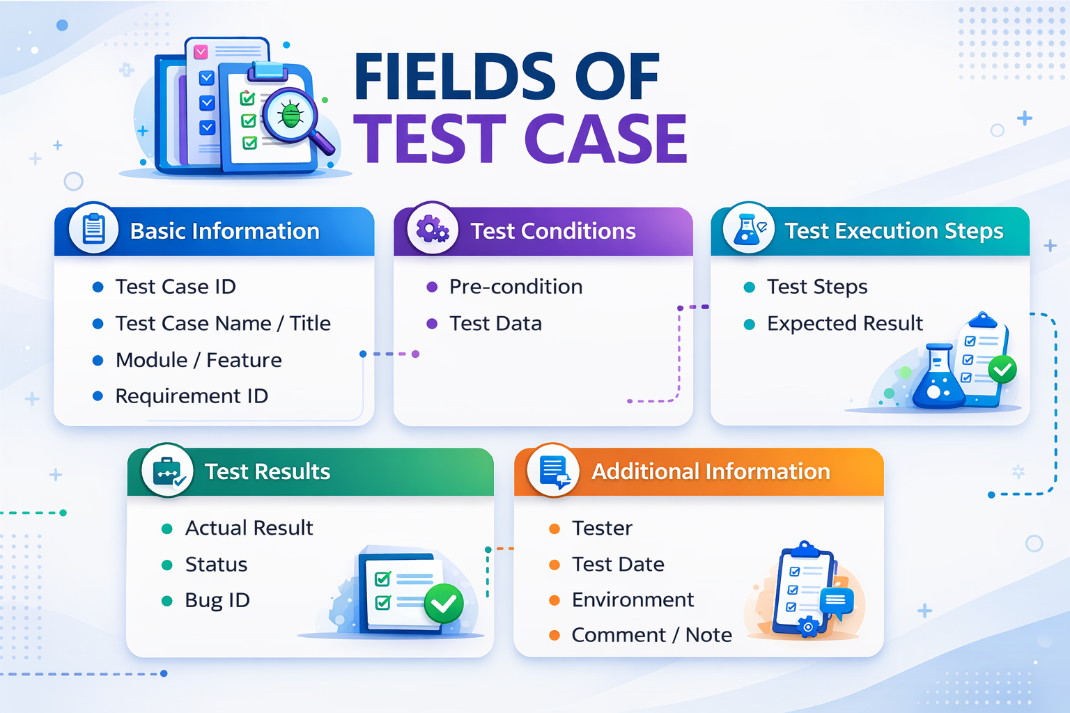

Slide 3
1. Basic Information
Test Case ID – Unique identifier for the test case
Test Case Name / Title – Describes the test objective
Module / Feature – Feature or component being tested
Requirement ID – Requirement from SRS
Priority – High / Medium / Low

Slide 4
2. Test Conditions
Pre-condition – Conditions required before executing the test
Test Data – Input data used during testing

Slide 5
3. Test Execution Steps
Test Steps – Detailed steps to perform the test
Expected Result – Expected system behavior after executing steps

Slide 6
4. Test Results
Actual Result – Actual outcome during test execution
Status – Pass / Fail
Bug ID – Reference to the bug if the test fails

Slide 7
5. Additional Information
Tester – Person who executed the test
Test Date – Date when the test was executed
Environment – Dev / SIT / UAT / Production
Comment / Note – Additional remarks or observations

Slide 8
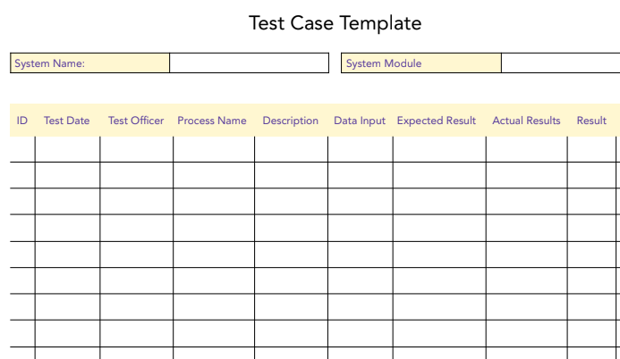
Example

Slide 9

THANK YOU

